Slide 1
CSE 308 Software Engineering and Information System Design Sessional
Automation of
BCB’s
Game Development Committee
Group Members:
1005091
1005111
1005113
1005115
1005120
Group No: 01

Slide 2
Subsystems
Program Management System
Divisional Cricket Management System
Game Education Management System
Academy Operations Management System
Coach Management System
Control Management System

Slide 3
Program management
System

Slide 4
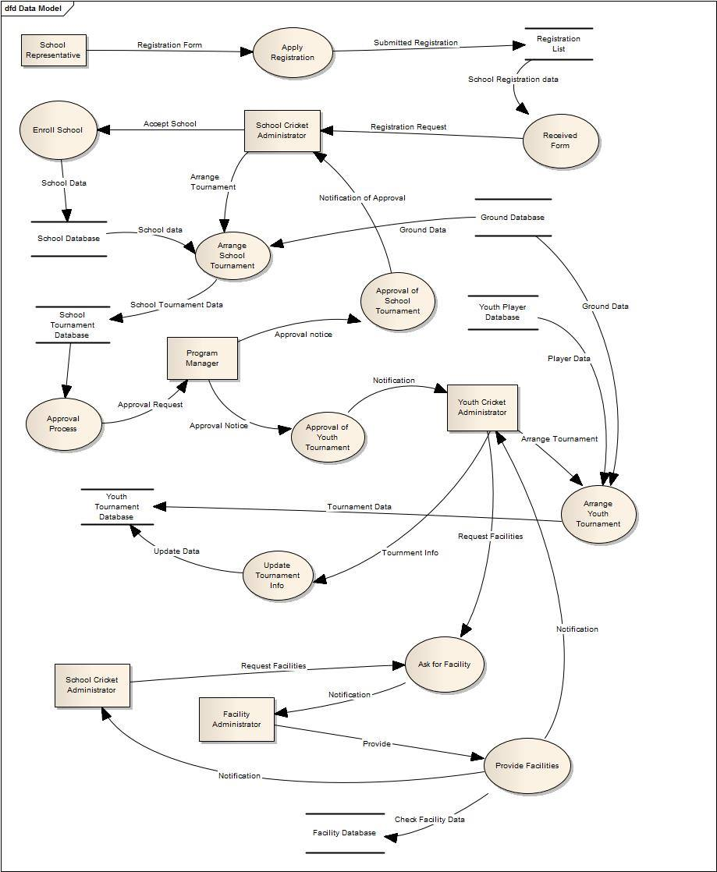
Data Flow diagram

Slide 5
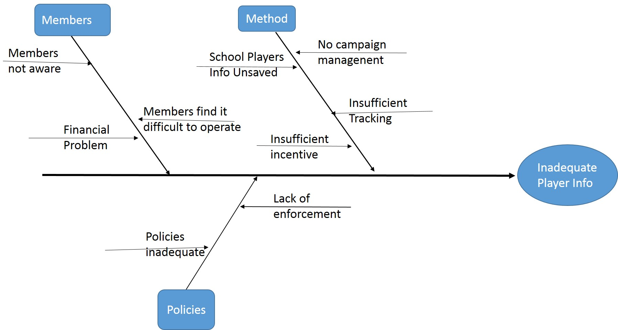
Fish Bone diagram

Slide 6
Divisional
Cricket management
System

Slide 7
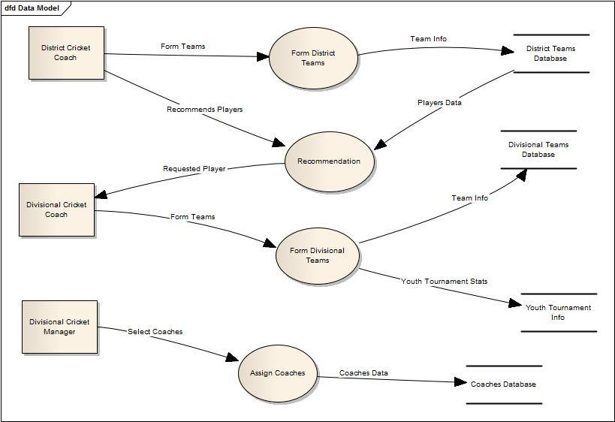
Data Flow diagram

Slide 8
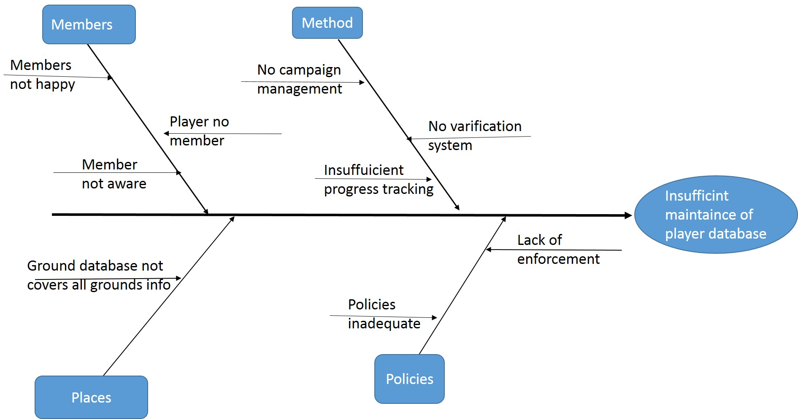
Fish Bone diagram

Slide 9
Academy Operations
management
System

Slide 10
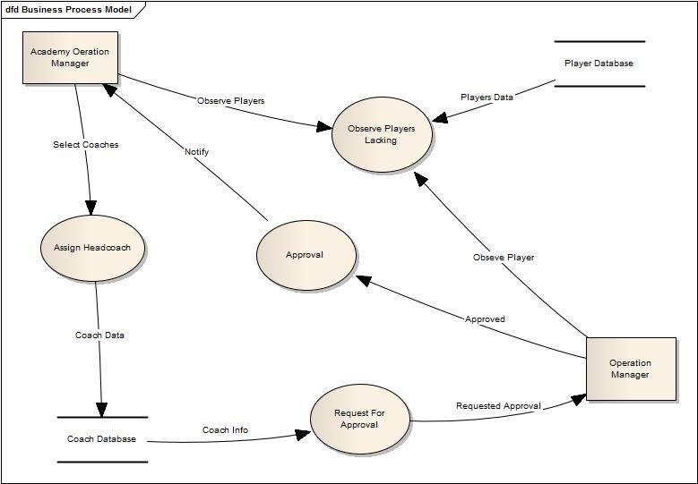
Data Flow diagram

Slide 11
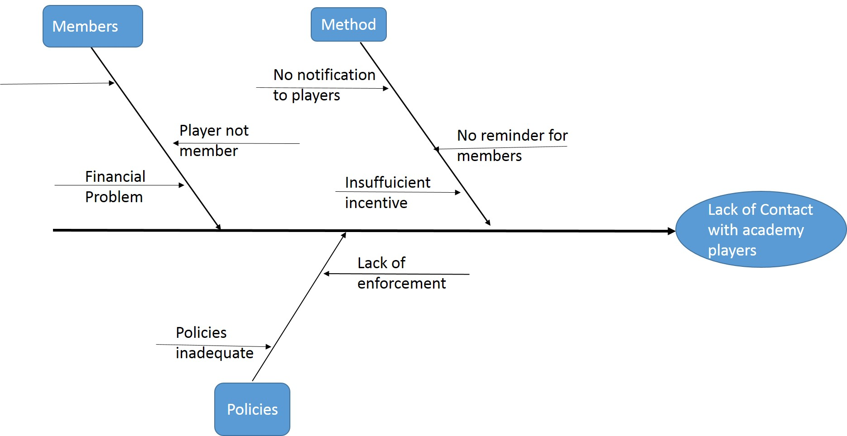
Fish Bone diagram

Slide 12
Coach management
System

Slide 13
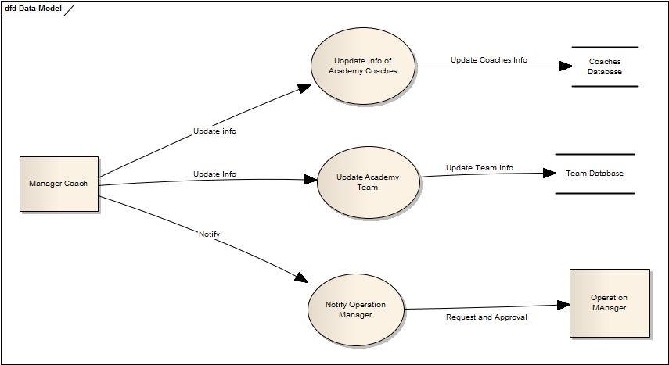
Data Flow diagram

Slide 14
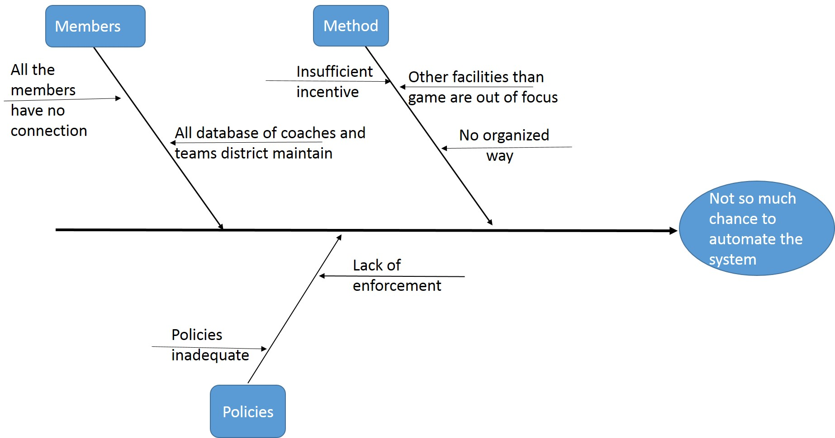
Fish Bone diagram

Slide 15
Control
management
System

Slide 16
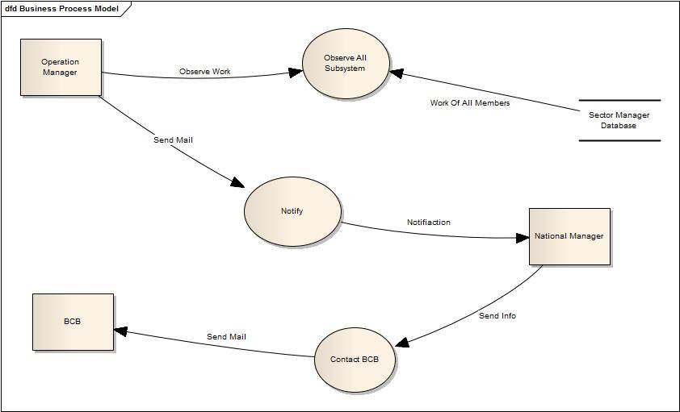
Data Flow diagram

Slide 17
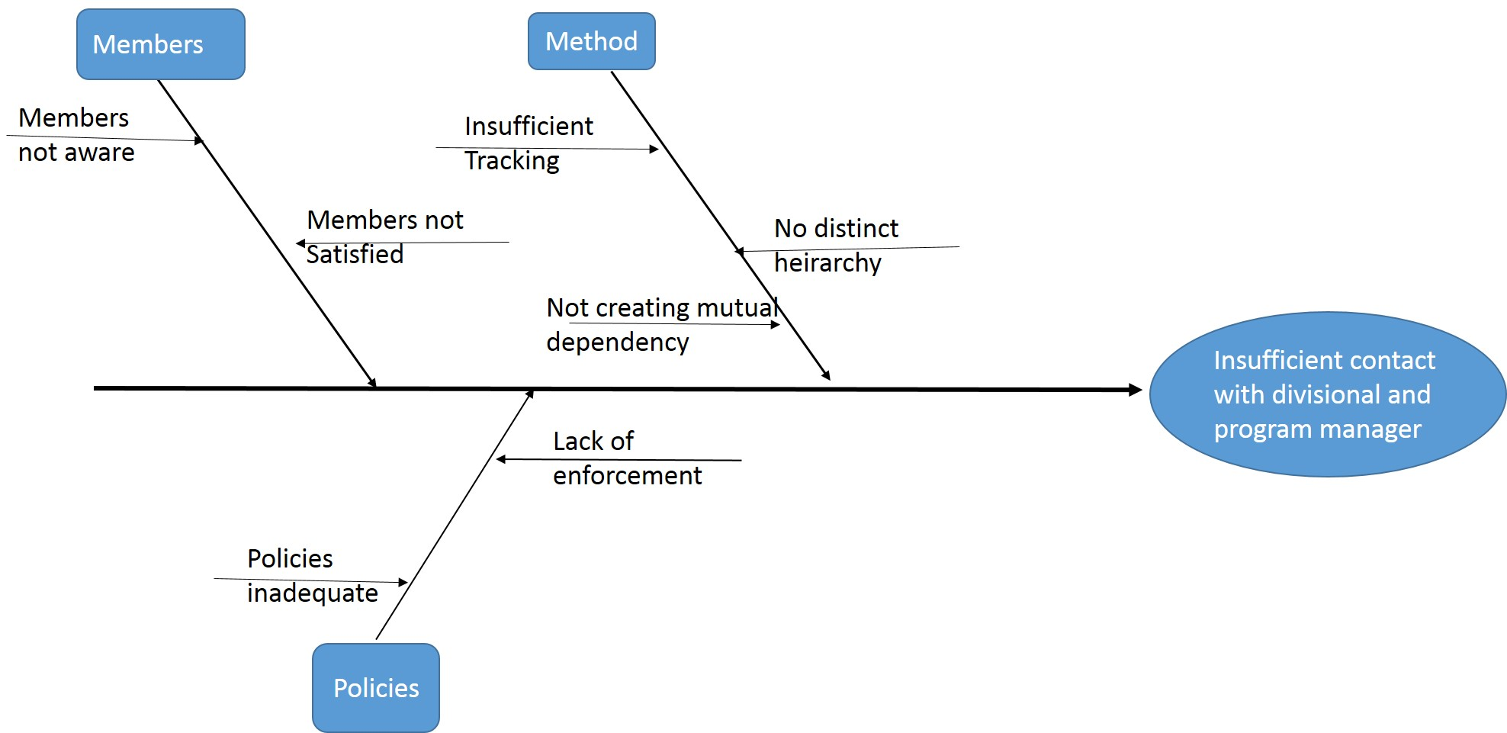
Fish Bone diagram

Slide 18
Operational Feasibility
Root level players database is maintained.
Improve communication between members.
Player selection system is improved
All Tournament Information is saved in database
By maintaining the database in sti of facilities , members can easily know the amount of equipment in store.
National level teams database is maintained, so that we can know the development of cricket in our country.

Slide 19
Cultural Feasibility
Players are benefited largely due to our player selection and management system
Grounds will be kept under keen observation for proper maintenance so that they are always prepared for playing matches.
All the coaches will find it easier to select and manage his team members .
Committee members are facilitated in observing the work of the officials working under respective members

Slide 20
Technical Feasibility
Tools used to implement this system are:
.net
Available
Easier to implement
MySQL for database
PHP for Server side scripting.
These Sources are easily Available

Slide 21
Technical Feasibility
Practical Implications
Internet Connection is almost everywhere in Bangladesh
System engineers and programmers will handle all kinds of problems in system.
Operating a computer is not a hard work now a days.
Everyone in the Game Development committee has the ability to operate the system.

Slide 22
Cost Analysis
Development costs
Sector | No of employee |  | Costs
System Analysts (30,000tk/month) | 2 | 6months | 360000 BDT
Programmer (50,000tk/month) | 3 | 3months | 450000 BDT
GUI designer (20,000tk/month) | 1 | 2months | 40000 BDT
Database Specialists (30,000tk/month) | 2 | 3months | 180000 BDT
Total Development costs: 10,30,000 BDT

Slide 23
Cost Analysis
Annual operating costs
Sector | No of employee | Costs
Programmer (30,000tk/month) | 1 | 360000 BDT
System librarian (30,000tk/month) | 1 | 360000 BDT
Maintenance agreement for server: (2000tk/year) | ---- | 2000 BDT
Internet Connection (2000tk/month) | ---- | 240000 BDT
Total costs: 746000 BDT

Slide 24
Tangible Benefits
Decrease Response Time
Reduce School registration steps
Save Time
Reduce paper works

Slide 25
Intangible Benefits
Improve player selection system
Improve Tournament scheduling system
Monitoring over players is easier
Better communication between members of this committee
Better monitoring others work
Better decision making
Better service to community

Slide 26
Thank You

